Slide 1
Welcome to City of Urbandale 2026 Open Enrollment

Slide 2
Welcome to City of Urbandale Open Enrollment
Open Enrollment is your annual opportunity to make changes to your benefits for the new plan year, effective January 1, 2026. During Open Enrollment, you may opt to do the following:
Change or opt out of coverage
Choose new benefit options
Enroll eligible family members in your benefits
Enroll in coverage, if eligible, but not currently covered
Annual Benefits Open Enrollment Period for the 2026 plan year:
10/20/25 to 11/3/2025 for an Effective Date of January 1, 2026

Slide 3
Special Enrollment Periods
Elections made at Open Enrollment will remain until the next open enrollment unless you or your family members experience a qualifying event. If you experience a qualifying event, you must contact HR within 30 days.
Qualifying events include:
Gaining a new dependent by Marriage, Birth, Adoption, or Placement for Adoption,
Loss of Other Coverage
Loss of Coverage for Medicaid or a State Children’s Health Insurance Program
Gaining eligibility for Medicaid or a State Children’s Health Insurance Program

Slide 4
What Is New?
New for Open Enrollment 2026:
Added a hearing aid benefit through Wellmark BCBS with a cap of $2,500 every three years
Moving from Avesis to EyeMed for vision coverage
EyeMed is offering improved vision coverage at a lower cost
Moving from Sun Life to Symetra for your life, disability, accident, and critical illness coverage
Symetra is offering a one-time special enrollment on the voluntary life up to $150,000 with no health questions
Symetra is offering improved benefits at the same cost on both the accident and critical illness policies

Slide 5
Premiums

Slide 6
Medical Premiums
Employee Contribution Per Pay Period
Benefit Plan | Full-Time
Employee | $38.73
Employee + Spouse | $79.33
Employee + Child(ren) | $73.32
Family | $118.87

Slide 7
Dental Premiums
Employee Contribution Per Pay Period
Benefit Plan | Full-Time
Employee | $1.47
Employee + Spouse | $2.93
Employee + Child(ren) | $3.31
Family | $6.25

Slide 8
Vison Premiums
Employee Contribution Per Pay Period
Benefit Plan | Full-Time
Employee | $0.39
Employee + Spouse | $0.68
Employee + Child(ren) | $0.81
Family | $1.01

Slide 9
Plans Offered

Slide 10
Medical Plans Offered
You have one medical plan.
PPO copay plan
Wellmark
Plan covers preventive care at 100%
Plan include prescription drug coverage through Wellmark

Slide 11
Insurance Terms to Know
Deductible
The amount you pay for health care services before your health insurance begins to pay. Plans with a higher deductible typically have a lower premium.
Coinsurance
A fixed dollar amount for services.
Example: If your plan has 20% coinsurance for a service and it costs $100, you pay $20.
Copay
A flat dollar amount for services.
Contribution
The amount employees pay out of their paycheck for the plan they select.
Out of Pocket Maximum
The most you'll have to pay during a calendar year for health care services. This includes deductible, coinsurance and copays.
Preventive Care
Part of a routine physical or checkup, preventive care includes immunizations, lab tests, screenings and other services intended to prevent illnesses.
Notes:
Before we review each of the plans in detail, let’s cover a few important insurance terms to know:
First, is deductible. This is the amount you pay for your healthcare services before the plan will kick in. Typically, the higher the deductible, the less the plan will cost.
The next term you'll see is co pay. A co pay is a flat dollar amount you pay for services like office visits or prescriptions.
Next is co insurance. This is a split percentage of costs that you and your insurance pay for medical expenses, after your deductible has been met.
Another feature of all medical plans is the out of pocket maximum. This is the most you would pay towards health care services in a given year. If you hit this maximum, your plan would begin to pay for the rest of your health services in full for the remainder of the plan year.
Preventive care is your routine care intended to prevent illnesses, and is covered in full with no deductible or co pay.
Lastly is contribution. Your contribution is the amount you pay out of your paycheck for your healthcare plan. The contribution is the difference between the state hard cap and the premium for that plan.

Slide 12
80% Coinsurance Large Claim Example
First claim submission of plan year:
In-Network outpatient surgery total cost after discounts = $12,000
Deductible = $1,000
$11,000 remaining of claim
Wellmark pays 80% = $8,800
You owe 20% = $2,200. However, the single OOP max is $2,000 so you only pay $1,000. The remaining balance is covered
Reminder: Any preventive care and office visits are not subject to the deductible or coinsurance.
Notes:
Let’s look at this with a claim example. Say you're enrolled in a single plan, and you have a major surgery as your first claim of the plan year, and the cost after the Blue Cross network discount is $12,000. The plan has a $2000 deductible, so you would be responsible for that before Blue Cross would cover anything.
After that, Blue Cross picks up 80% of the balance through your co insurance. The remaining $2,000 would be your responsibility. However, the co insurance maximum for a single on this plan means you only pay 1,000 dollars out of pocket and the remaining balance is covered. From this point, your only health care costs would be copays until your out of pocket maximum is reached. If the rest of your $4,000 Out of Pocket max is fulfilled from future copays, any major medical and Rx would be fully covered for the rest of the year.
Even in a worst scenario claim year, you will never pay more than your Out of Pocket Max for in-network claims!

Slide 13
Medical Plan Grids
 | City of Urbandale Wellness Plan
 | In-Network | Out-of-Network
Lifetime Benefit maximum | Unlimited
Calendar Year Deductible | $1,000 single / $1,500 family | $1,000 single / $1,500 family
Calendar Year Out-of-Pocket Maximum | Health: $2,000 single / $3,000 family Drug Card: $4,600 single / $10,200 family | Health: $2,000 single / $3,000 family Drug Card: $4,600 single / $10,200 family
Coinsurance | 20% | 40%
Doctor’s office
Primary Care Office Visit | $10 copay per provider per date of service | 40% after deductible
Specialist Office Visit | $10 copay per provider per date of service | 40% after deductible
Preventive Care* | 0% | Well-child care, fecal occult and mammogram: 40% after deductible; Others: Not covered
Inpatient Services | Deductible + 20% Coinsurance | Deductible + 40% Coinsurance
Outpatients Services | Deductible + 20% Coinsurance | Deductible + 40% Coinsurance
Emergency Room | Deductible + 20% Coinsurance | Deductible + 20% Coinsurance
Prescription drug’s**
Retail – Tier 1 (34 days supply) | $10 copay per prescription | Not covered
Retail – Tier 2 (34 days supply) | $30 copay per prescription | Not covered
Retail – Tier 3 (34 days supply) | $50 copay per prescription | Not covered
Retail – Tier 4 (34 days supply) | $75 copay per prescription | Not covered
Specialty Drugs*** (30 days supply) | $100 copay per prescription | Not covered
Retail Maintenance (91-day) | Included | Not covered
Mail Order (90-day) | Included | Not covered
*Your plan includes coverage for certain specialty drugs through PrudentRx. If you choose to opt into the PrudentRx program, your deductible and coinsurance will be waived for drugs listed on the PrudentRx drug list. Information about the PrudentRx program can be found in your plan document in these sections: What You Pay, Details-Covered and Not Covered.
**Annual vision exams are covered under the plan.

Slide 14
How Can You Save Money on Healthcare?

Slide 15

You have control over more than you may think!
Over 60% of healthcare expenses are related to our lifestyles.
Be an advocate for your own health
“Shop” for a provider for major procedures
Develop a relationship with a pharmacist
When non-emergent; use a stand-alone facility
Urgent Care, DMOS, Iowa Radiology, Iowa Clinic
Focus on prevention (PCP, Therapy, Chiropractors)
Preventive billing practices
Use virtual care for common conditions
Enroll in a flexible spending account
Utilize prescription drug savings programs:
Good Rx, Amazon Pharmacy, Cost Plus Drugs
Utilize PrudentRx through Wellmark CVS
Ask for generic alternatives

Slide 16




Where to Go for Care
Where to go for care
Save time and money by knowing your options
Primary Care
Free when used for preventive care!
Generally scheduled as an annual visit
See your PCP to be referred to specialists
Virtual Care
$
Average wait time:
3-10 min.
Easy and convenient; Best for things like rashes, stings, eye irritation, minor burns and cuts, sore throat, cough and cold
Urgent Care
$$
Average wait time:
60-90 min.
Seek urgent care for things like sprains and strains, moderate ear infections, cuts that require stitches, x-rays, and lab tests
Emergency Room
$$$
Average wait time:
2.5 hours – 4 hours
You should only visit the ER for life-threatening conditions or things like chest pain, broken bones, poisoning, seizures, slurred speech, and bleeding
Notes:
Knowing the right place to go for care can also help you save money and time.
You can usually avoid higher costs with non-emergent issues by using your primary care physician or seeking out care through online visits.
In an urgent or emergency situation however, you should always go to urgent care or the emergency room.

Slide 17
A Look Into Healthcare Costs
You’re enrolled in a single coverage health plan and need to seek care.
View your potential care costs to understand how they differ.
 | Actual Charges | Your Charges
PCP | $207 | $10
Non-PCP | $285 | $10
Emergency Room | $1,326 | Deductible + Coins.
Urgent Care | $193 | $10
TeleHealth | $64 | $0

Slide 18
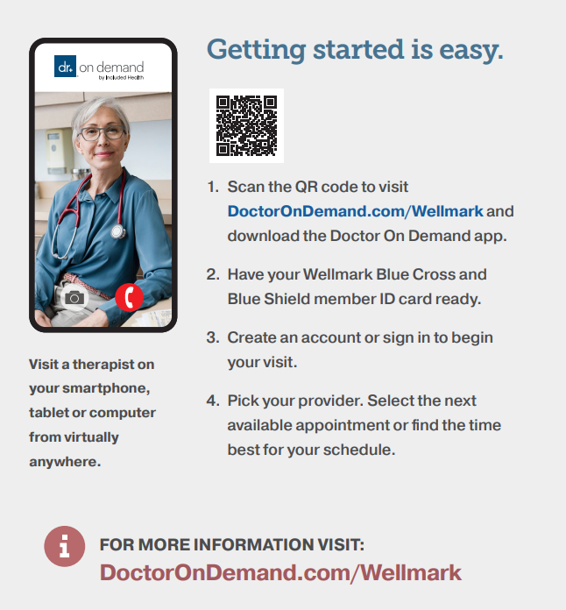
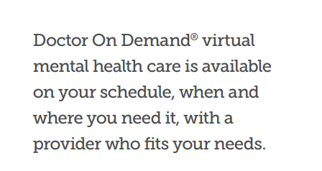
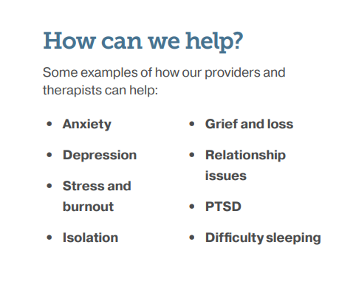
Think Virtual Care First
Doctor on Demand

Slide 19

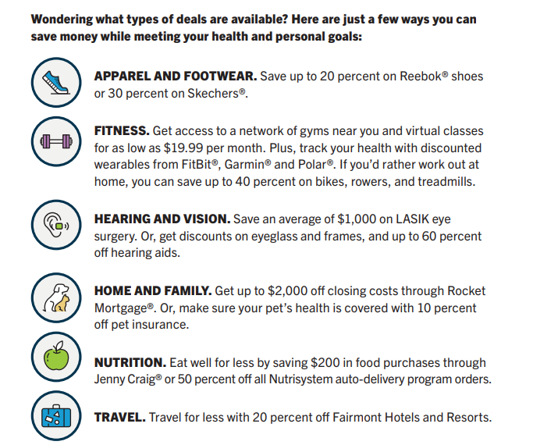
Wellmark 365 Discounts

Slide 20
Dental Plans Offered
Dental coverage is provided by Delta Dental.
Services | In-Network (Delta Dental PPO) | In-Network (Delta Dental Premier) | Out-of-Network
Calendar Year Deductible | $15 per person; $45 family limit | $25 per person; $75 family limit | $25 per person; $75 family limit
Calendar Year Benefit Maximum | $2,000 | $2,000 | $2,000
Preventive Dental Services (cleanings, exams, x-rays) | 100% | 100% | 100%
Basic Dental Services (fillings, root canal therapy, oral surgery) | 90% after deductible | 80% after deductible | 80% after deductible
Major Dental Services (extractions, crowns, inlays, onlays, bridges, dentures, repairs) | 50% after deductible | 50% after deductible | 50% after deductible
Orthodontia Services (Adults and children to age 26) | 50% to $2,000 lifetime maximum | 50% to $2,000 lifetime maximum | 50% to $2,000 lifetime maximum

Slide 21
Delta Dental To-Go Benefit
Annual Maximum Carryover
 | Year 1 | Year 2
Annual Benefit Maximum | $2,000 | $3,500
Eligible Benefit Used | $500
Unused Annual Benefit Maximum | $1,500
To-Go Annual Maximum Carryover | $1,500
Key Guidelines
You must have submitted at least one claim during the benefit plan year
The carryover amount cannot exceed the ABM
The total available benefit cannot exceed twice the ABM
If coverage changes or lapses, your balance may reset

Slide 22
Vision Plans Offered
Vision coverage is provided by EyeMed.
Services | In-Network (any EyeMed Network provider) | Out-of-Network (any qualified non-network provider of your choice)
Eye Exam — once every 12 months | $10 copay then covered in full $0 at PLUS Providers | Reimburse up to $40
Lenses — once every 12 months
Single Vision Lenses | $15 copay then covered in full | Reimburse up to $30
Bifocal Lenses | $15 copay then covered in full | Reimburse up to $50
Trifocal Lenses | $15 copay then covered in full | Reimburse up to $70
Lenticular Lenses | $10 copay then covered in full | Reimburse up to $80
Frames — once every 24 months | PLUS Providers: $250 allowance; Plus 20% off All other providers: $200 allowance; Plus 20% off | Reimburse up to $100
Contact Lenses — once every 12 months if you elect contacts instead of lenses/frames
Allowance | Conventional: $250 plus 15% off at PLUS Providers; $200 plus 15% off at all other providers Disposable: $250 at PLUS Providers; $200 at all other providers | Reimburse up to $130
Medically Necessary | Covered in full | Reimburse up to $250
Separate Fitting Allowance | Up to $40 | N/A
www.eyemed.com

Slide 23
Vision Plan Enhancements
Plan Benefit | Avesis Vision | EyeMed Vision
Eye Exam | $10 Copay | Standard: $10 Copay PLUS Providers: $0 Copay
Frames | $150 Allowance + 20% off | Standard: $200 Allowance + 20% off PLUS Providers: $250 Allowance + 20% off
Contact Lenses | $130 Allowance + 10% off | $200-$250 Allowance + 15% off
Contact Fitting | Included in contact lens allowance | Standard: Up to $40 Allowance Premium: 10% off retail

Slide 24
How the Flexible Spending Account (FSA) Works
How the Flexible Spending Account (FSA) Works
FLEXIBLE SPENDING ACCOUNT – Offered Through HealthEquity
You can save money on your healthcare and/or dependent day care expenses with an FSA. You set aside funds each pay period on a pre-tax basis and use them tax-free for qualified expenses.
You pay no federal income or Social Security taxes on your contributions to an FSA (that’s where the savings comes in). Your FSA contributions are deducted from your paycheck before taxes are withheld, so you save on income taxes and have more disposable income.
Healthcare FSA Annual Spending Limit: $3,400 (2.5-month grace period. Claims must be incurred on or before 3/15/2026 and submitted by 3/31/2026)
Dependent Care FSA Annual Spending Limit: $7,500 ($3,750 if married and filing separately)

Slide 25
Eligible FSA Expenses – Not a Full List
Medical bills through insurance
Prescription eyeglasses
Contact lens solution
Chiropractic care
Acupuncture treatments
Over-the-counter pain relievers
Menstrual care products
Diabetic supplies
Hearing aids
Physical therapy
Thermometers
Sleep aids
Fertility treatments
Doula services
Oura Ring and Whoop Band

Slide 26

How Much Can I Save?
An example…
 | With FSA | Without FSA
Annual Salary | $50,000 | $50,000
Pre-tax Contribution | ($2,000) | $0
Taxable Income | $48,000 | $50,000
Federal Income, Social Security and Medicare Expenses | ($11,040) | ($11,500)
After tax dollars spent | $0 | $2,000
Real Spendable Income | $36,960 | $36,500
Savings with FSA | $460 | $0
Notes:
Here’s a quick example of how using an FSA or HSA can help you take advantage of tax laws and keep more of your money!

Slide 27
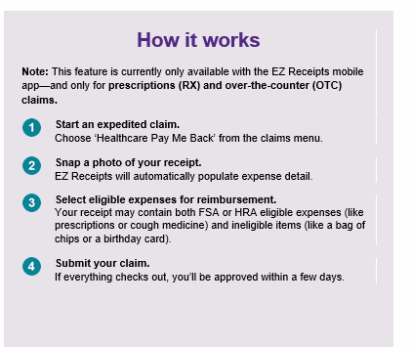
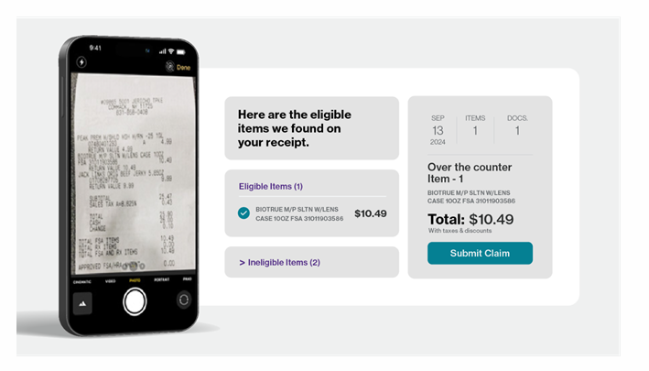
FSA Receipt Reporting
Health Equity

Slide 28
Life & Accidental Death & Dismemberment (AD&D) Plans Offered
Basic Life and AD&D insurance:
City of Urbandale pays for this coverage
This coverage is through Symetra
This coverage will pay if you pass away or become seriously injured as a result of an accident
Full-Time Non-Union – 1x annual earning to max $200,000
Police and Fire - $50,000
Labor Union - $10,000
PPT30 – Pay 50% of the $10,000 offered
Optional Life insurance:
This coverage is through Symetra
For yourself – 5x annual earnings to a maximum of $500,000
For your spouse – Increments of $5,000 up to $250,000 (not to exceed 50% of EE's amount)
Unmarried dependent children from birth to age 26: $10,000
Symetra is offering a one-time enrollment up to $150,000 election with no health questions

Slide 29
Disability Plans Offered
Long Term Disability insurance:
Symetra
Company Paid
Full-Time Non-Union Benefit
Symetra | Long-term Disability
Benefit Amount | 60% monthly earnings
Maximum Benefit | $6,000 per month
Benefit Duration | SSNRA or To age 65
Elimination Period | 90 days

Slide 30
Symetra Value Adds
Employee Assistance Program
Well-Being Coaching
Cognitive Behavioral Therapy
Travel Assistance
Identity Theft Assistance
Beneficiary Assistance
EstateGuidance
Please refer to the portal for more information.

Slide 31
Accident Plan Offered
Administered by Symetra
The Accident plan provides cash payments directly to you to help cover out-of-pocket costs, such as deductibles or coinsurance. The full schedule of benefits payable for accidental injuries include initial/follow-up treatment, ambulance trips, medical imaging, surgeries, concussion, dislocations and fractures, hospital stays, AD&D, and health screening benefits. This benefit is for on the job and off the job. Some benefits are payable once per covered accident, while others are once per plan year. See Benefit Summary for detailed information and schedule of benefits and exclusions.
Don’t Forget - $50 wellness screening benefit once per year!
Can I keep the current voluntary benefits I have through Sun Life?
Yes! All employees currently enrolled in the accident and critical illness benefits through Sun Life will receive a notice stating that they can port their coverage to an individual policy. This will allow you to pay Sun Life directly monthly.

Slide 32
Accident Plan Enhancements
Plan Benefit | Sun Life | Symetra
Coverage | Off Job | 24 Hour
Hospital ICU | Admission: $2,500 Confinement: $300 (Up to 15 days) | Admission: $3,000 Confinement: $600 (up to 30 days)
Non-Emergent Care | $100 Physician’s Office / Urgent Care | $150 Physician’s Office / Urgent Care
Wellness | $50 1x per insured per year (test) | $50 1x per covered per year (physicals, dental, eye included)
Miscellaneous |  | Organized sports rider 25%

Slide 33
Accident Plan Rates
Employee Contribution Per Pay Period
Employee Tier | Rate
Employee Only | $3.53
Employee & Spouse | $5.57
Employee & Children | $6.32
Family | $8.37

Slide 34
Critical Illness Plan Offered
Administered by Symetra
Critical illness insurance provides a lump-sum payment for an insured person diagnosed with any of the following critical illnesses while insurance is in effect for the insured person, after any applicable waiting period and subject to any pre-existing condition limitation: Cancer, Heart Attack, Stroke, Organ Transplant, Kidney Failure, and more. See Benefit Summary for detailed information and schedule of benefits and exclusions.
Don’t Forget - $50 wellness screening benefit once per year!

Slide 35
Critical Illness Plan Enhancements
Plan Benefit | Sun Life | Symetra
Covered Critical Illnesses |  | Expanded list of covered illnesses
Same Illness Diagnosis | 100% recurrence (365-day separation) | 100% recurrence (1 month separation)
Different Illness Diagnosis | 1 x each Illness (180-day separation) | 1 day
Maximum Benefit | 1 x each illness, 1 x each recurrence | No annual or lifetime maximum if separation periods are met

Slide 36
Critical Illness Plan Rates – Tobacco
 | Employee Attained Age | Per $1,000 | $10,000 | $20,000 | $30,000 | $40,000
Employee Only--Tobacco | 24 and Under | 0.49 | $4.90 | $9.80 | $14.70 | $19.60
 | 25-29 | 0.54 | $5.40 | $10.80 | $16.20 | $21.60
 | 30-34 | 0.66 | $6.60 | $13.20 | $19.80 | $26.40
 | 35-39 | 0.94 | $9.40 | $18.80 | $28.20 | $37.60
 | 40-44 | 1.41 | $14.10 | $28.20 | $42.30 | $56.40
 | 45-49 | 2.09 | $20.90 | $41.80 | $62.70 | $83.60
 | 50-54 | 3.25 | $32.50 | $65.00 | $97.50 | $130.00
 | 55-59 | 4.48 | $44.80 | $89.60 | $134.40 | $179.20
 | 60-64 | 5.55 | $55.50 | $111.00 | $166.50 | $222.00
 | 65-69 | 7.58 | $75.80 | $151.60 | $227.40 | $303.20
 | 70-74 | 9.97 | $99.70 | $199.40 | $299.10 | $398.80
 | 75 and Over | 12.52 | $125.20 | $250.40 | $375.60 | $500.80
 | Employee Attained Age | Per $1,000 | $5,000 | $10,000 | $15,000 | $20,000
Child Only--Tobacco | Child --per $1,000 Benefit | $0.09 | $0.45 | $0.90 | $1.35 | $1.80
 | Employee Attained Age | Per $1,000 | $10,000 | $20,000 | $30,000 | $40,000
Spouse Only--Tobacco | 24 and Under | 0.49 | $4.90 | $9.80 | $14.70 | $19.60
 | 25-29 | 0.54 | $5.40 | $10.80 | $16.20 | $21.60
 | 30-34 | 0.66 | $6.60 | $13.20 | $19.80 | $26.40
 | 35-39 | 0.94 | $9.40 | $18.80 | $28.20 | $37.60
 | 40-44 | 1.41 | $14.10 | $28.20 | $42.30 | $56.40
 | 45-49 | 2.09 | $20.90 | $41.80 | $62.70 | $83.60
 | 50-54 | 3.25 | $32.50 | $65.00 | $97.50 | $130.00
 | 55-59 | 4.48 | $44.80 | $89.60 | $134.40 | $179.20
 | 60-64 | 5.55 | $55.50 | $111.00 | $166.50 | $222.00
 | 65-69 | 7.58 | $75.80 | $151.60 | $227.40 | $303.20
 | 70-74 | 9.97 | $99.70 | $199.40 | $299.10 | $398.80
 | 75 and Over | 12.52 | $125.20 | $250.40 | $375.60 | $500.80
*Rates reflect a monthly cost

Slide 37
Critical Illness Plan Rates – Non-Tobacco
 | Employee Attained Age | Per $1,000 | $10,000 | $20,000 | $30,000 | $40,000
Employee Only | 24 and Under | $0.48 | $4.80 | $9.60 | $14.40 | $19.20
 | 25-29 | $0.51 | $5.10 | $10.20 | $15.30 | $20.40
 | 30-34 | $0.60 | $6.00 | $12.00 | $18.00 | $24.00
 | 35-39 | $0.79 | $7.90 | $15.80 | $23.70 | $31.60
 | 40-44 | $1.06 | $10.60 | $21.20 | $31.80 | $42.40
 | 45-49 | $1.43 | $14.30 | $28.60 | $42.90 | $57.20
 | 50-54 | $2.02 | $20.20 | $40.40 | $60.60 | $80.80
 | 55-59 | $2.59 | $25.90 | $51.80 | $77.70 | $103.60
 | 60-64 | $3.05 | $30.50 | $61.00 | $91.50 | $122.00
 | 65-69 | $3.92 | $39.20 | $78.40 | $117.60 | $156.80
 | 70-74 | $5.24 | $52.40 | $104.80 | $157.20 | $209.60
 | 75 and Over | $7.39 | $73.90 | $147.80 | $221.70 | $295.60
 | Employee Attained Age | Per $1,000 | $5,000 | $10,000 | $15,000 | $20,000
Child Only | Child --per $1,000 Benefit | $0.09 | $0.45 | $0.90 | $1.35 | $1.80
 | Employee Attained Age | Per $1,000 | $10,000 | $20,000 | $30,000 | $40,000
Spouse Only | 24 and Under | $0.48 | $4.80 | $9.60 | $14.40 | $19.20
 | 25-29 | $0.51 | $5.10 | $10.20 | $15.30 | $20.40
 | 30-34 | $0.60 | $6.00 | $12.00 | $18.00 | $24.00
 | 35-39 | $0.79 | $7.90 | $15.80 | $23.70 | $31.60
 | 40-44 | $1.06 | $10.60 | $21.20 | $31.80 | $42.40
 | 45-49 | $1.43 | $14.30 | $28.60 | $42.90 | $57.20
 | 50-54 | $2.02 | $20.20 | $40.40 | $60.60 | $80.80
 | 55-59 | $2.59 | $25.90 | $51.80 | $77.70 | $103.60
 | 60-64 | $3.05 | $30.50 | $61.00 | $91.50 | $122.00
 | 65-69 | $3.92 | $39.20 | $78.40 | $117.60 | $156.80
 | 70-74 | $5.24 | $52.40 | $104.80 | $157.20 | $209.60
 | 75 and Over | $7.39 | $73.90 | $147.80 | $221.70 | $295.60
*Rates reflect a monthly cost

Slide 38
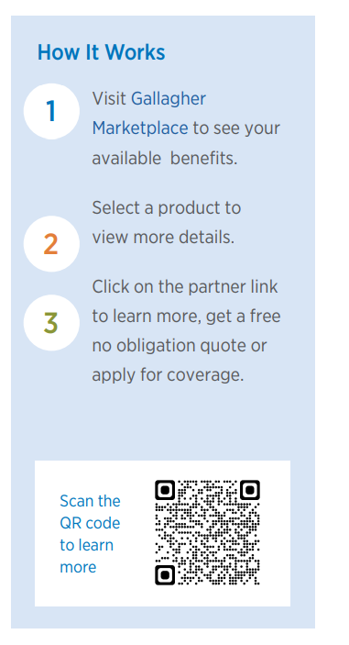
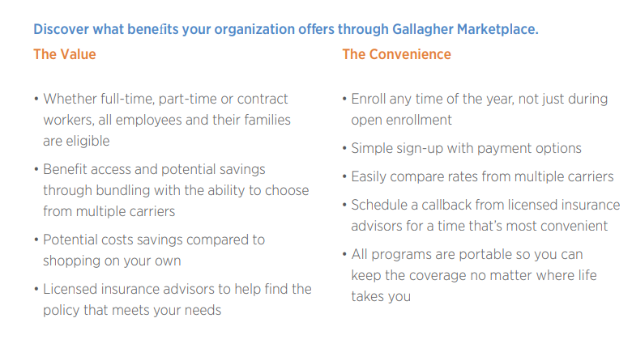
Employee Discount Program
Powered by Gallagher Marketplace
Included: Auto & Homeowners Insurance, Extended Vehicle Warranties, Pet Insurance, and Perk Spot (Travel, Gym, Cell Phone, Restaurant, Apparel, and Electronic Discounts from over 1,000+ partners)

Slide 39
Legal and Identity Theft Protection
LegalShield Coverage Includes:
Legal consultation and advice
Court representation
Dedicated provider law firm
Legal document preparation and review
Will preparation
Letters and phone calls made on your behalf
Speeding ticket assistance
24/7 emergency legal access
Identity Theft Services Include:
Identity consultation and advice
Dedicated licensed private investigators
Identity, credit, and financial account monitoring
Child monitoring
Full-service identity restoration
Real-time alerts
24/7 emergency access
Social media monitoring and online privacy reputation management

Slide 40
Summary & Next Steps

Slide 41
Next Steps
Review
Review current elections and consider your benefit needs
Review the 2026 Open Enrollment Benefit Information in Benefit Guide
Elect
Make elections via the HR Portal and use the paper forms for all voluntary coverages you want to change or add by 11/3/25.
Select beneficiaries for life insurance and update address and contact information
Confirm
Print a copy of your confirmation statement
Confirm elections and deduction amounts match selections

Slide 42
Questions?

Slide 43
Disclaimer
This document is an outline of the coverage proposed by the carrier(s), based on information provided by your company. It does not include all the terms, coverages, exclusions, limitations, and conditions of the actual contract language. The policies themselves must be read for those details. The intent of this document is to provide you with general information about your employee benefit plans. It does not necessarily address all the specific issues which may be applicable to you. It should not be construed as, nor is it intended to provide, legal advice. Questions regarding specific issues should be directed to your Human Resources/Benefits Department.

